Slide 1
EXPENSE OWL
-BY RANJINI M(43120250)

Slide 2
Abstract
Expense Owl is a web-based expense management system that simplifies daily financial tracking.
Users can record, categorize, and analyze expenses with features like recurring transactions,
currency selection, and visual reports. This system enhances accuracy, saves time, and encourages
responsible budgeting through automation and intuitive design.

Slide 3
Existing System
In the existing manual system, users manage expenses using notes, diaries, or spreadsheets.
These methods are time-consuming, prone to human error, and lack real-time analysis. Manual tracking
makes it difficult to identify spending patterns, resulting in poor financial planning and organization.

Slide 4
Proposed System
The proposed Expense Owl system automates expense management through a secure, web-based platform.
It allows users to add, edit, and categorize transactions, view reports, and automate recurring expenses.
The system supports data storage, theme customization, and provides analytical reports for better
financial decision-making.

Slide 5
Advantages
Eliminates manual errors in tracking expenses
Provides real-time data analysis through visual charts
Saves time and improves financial awareness
Offers customization options for themes and currencies
Supports recurring transactions and automated reports

Slide 6
Disadvantages
Requires internet connectivity for use
Initial setup may require basic technical knowledge
Data security depends on proper backend implementation

Slide 7
Hardware Requirements
Processor: Dual Core or higher
RAM: 4 GB or more
Hard Disk: Minimum 20 GB free space

Slide 8
Software Requirements
Frontend: HTML, CSS, JavaScript
Backend: Go (Golang)
Database: JSON / Lightweight Storage
Tools: VS Code, Node.js
OS Compatibility: Windows / Linux

Slide 9
Modules
1. Add Expense Module
2. View Expense Records Module
3. Reports Module
4. Settings Module
5. Recurring Transactions Module

Slide 10
Module Description
Add Expense Module – Enables users to add new expenses with details like name, category, and amount.
View Expense Records Module – Displays all recorded transactions with edit and delete options.
Reports Module – Generates visual charts for expense analysis.
Settings Module – Allows customization of currency, theme, and categories.
Recurring Transactions Module – Automates regular expenses or incomes based on user preferences.

Slide 11
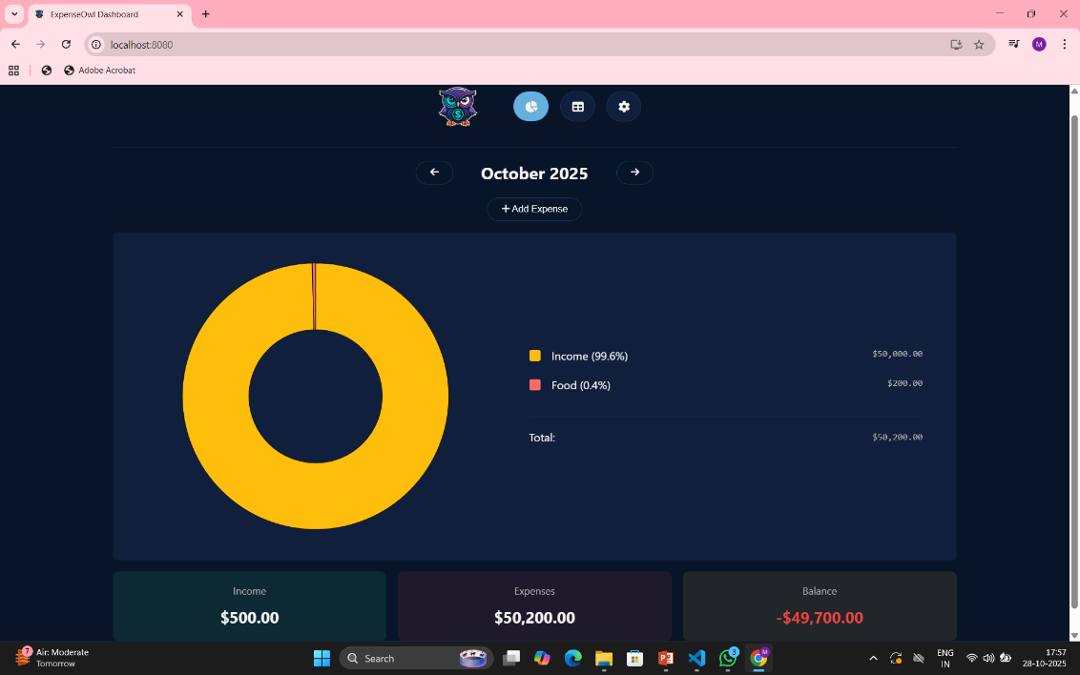
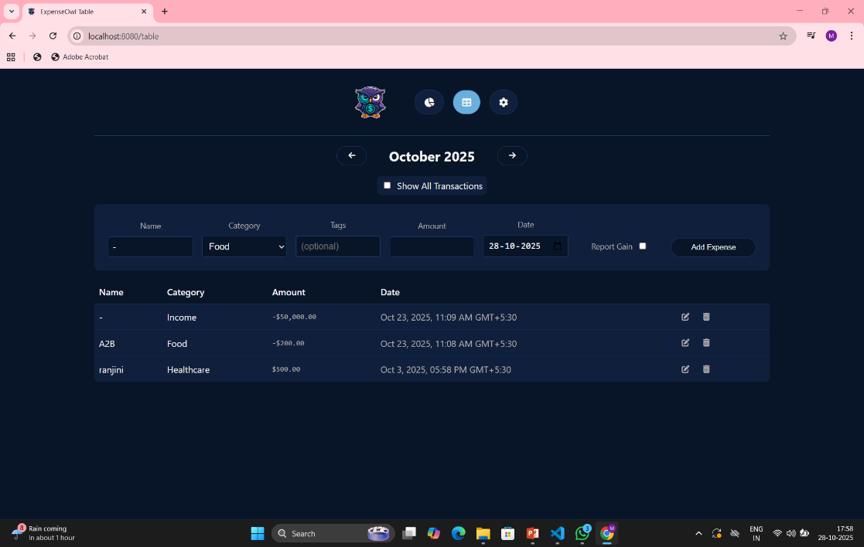
Sample Output
This slide can include screenshots of the Expense Owl user interface, such as the expense dashboard,
charts, and report views.

Slide 12
Conclusion
Expense Owl provides an efficient digital solution for personal financial management. It minimizes manual work, enhances data accuracy, and empowers users with better budget control. The system’s automation, report generation, and customization options make it a reliable personal finance assistant.

